Slide 1
P
Jensen/Melanis
P
E
E
Stone Scholastic Academy
Kindergarten - 8th Grade
Physical Education Remote Learning
Remember you can contact us anytime via email at sjensen2@cps.edu and gkmelanis1@cps.edu
@nadinegilkison
Notes:
I got my images from Unsplash (which is also a Google Slides add-on)

Slide 2
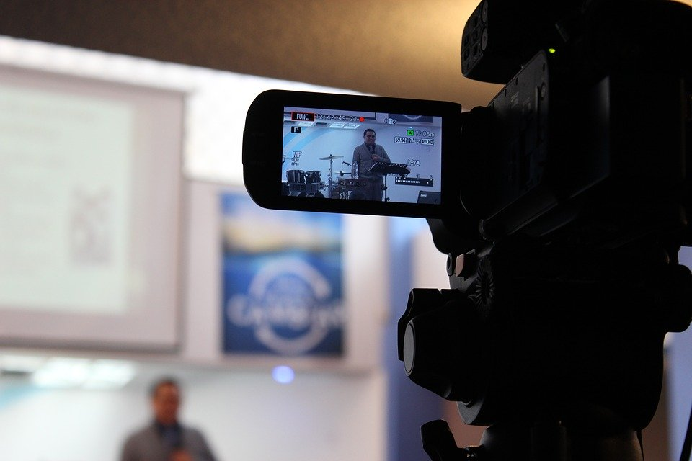
Instructions...
Record
Keep track of what you complete each day with a fitness log
Questionnaire
On Friday answer questions about your week.
What do I do?
You have options. Pick one of the six activies and do one a day.
Click
Each day click on the icon of your choice and do the activity.
@nadinegilkison

Slide 3
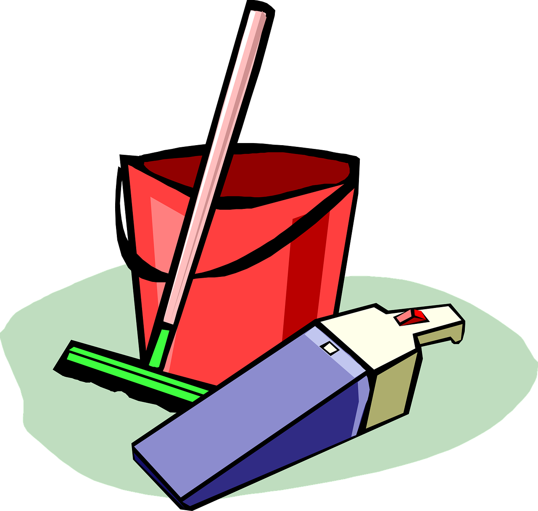
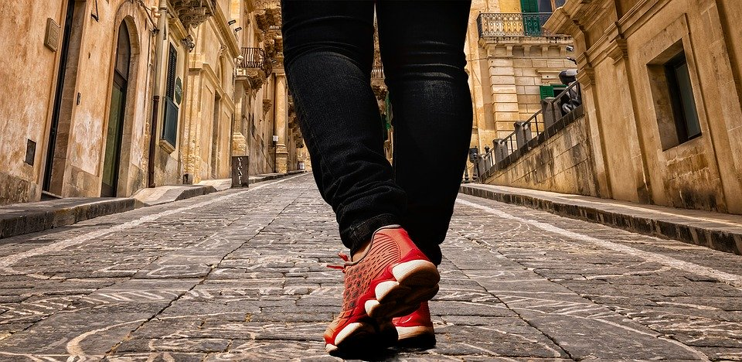
Tap the image to take you to the section you need.
Batman
Do a Chore
Black Panther
30 min walk
Captain America
Play an active game
@nadinegilkison
Notes:
Want to change the Emojis here? https://www.emojione.com/emoji/v4

Slide 4
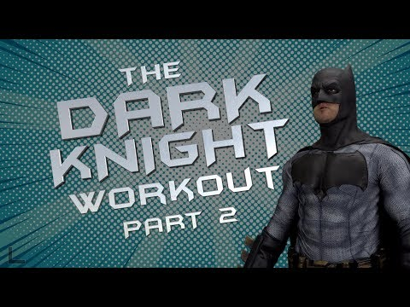
Batman
Train like Batman
Do your best!!
@nadinegilkison

Slide 5
Black Panther
Train like Black Panther
You’re doing great!!!
@nadinegilkison

Slide 6
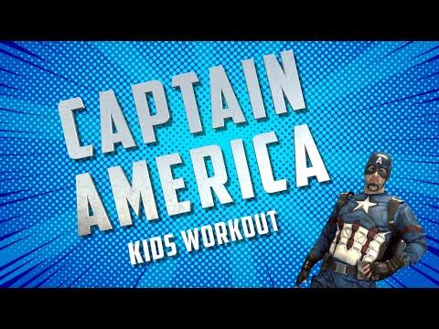
Captain America
Train like Captain America
Keep up the good work!!!
@nadinegilkison

Slide 7
Do a chore
What chore or chores did you help with today? Don’t forget to keep track of your activity with a log!
Do a chore of your parents choice
Good job
@nadinegilkison

Slide 8
30 min walk
Did you see anything interesting on your walk? Who were you with during your walk?
Take a 30 minute walk with your family
Way to stay active
@nadinegilkison
Notes:
Title of Hyperdoc-

Slide 9
Play an active game
What game did you choose to play? What skill or muscle did the game help you focus on?
Play an active game of your choice.
Great choice
@nadinegilkison
Notes:
Title of Hyperdoc-

Slide 10
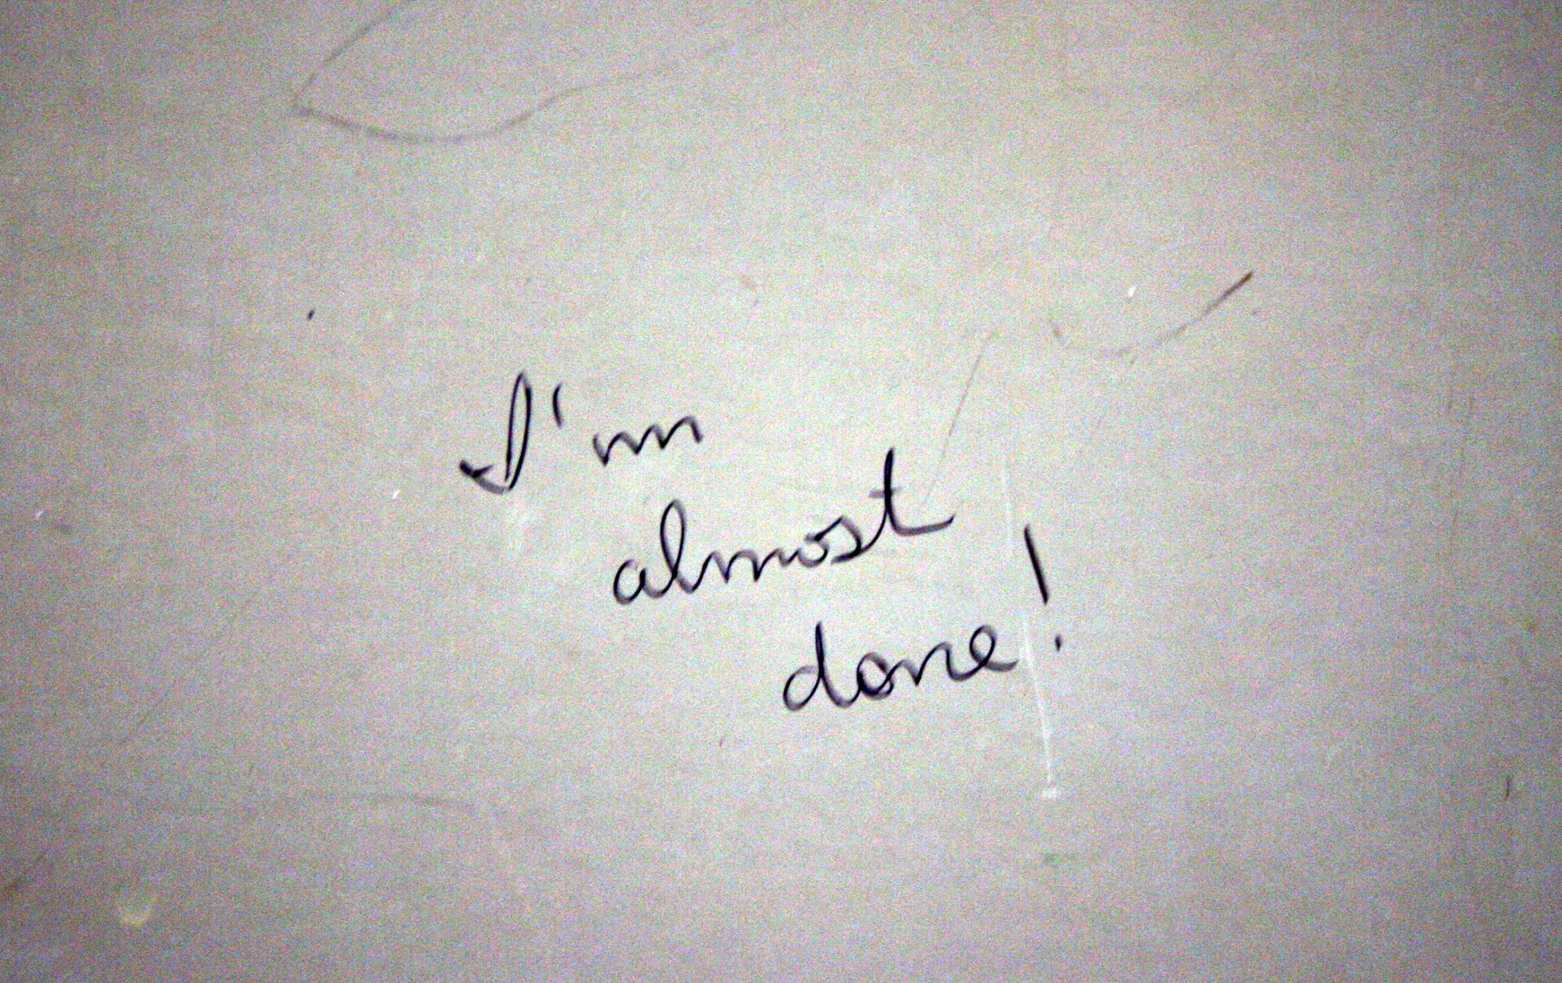
Formative Assessment
Don’t forget to record your workouts each week and answer your assignment questions.
What activity did you complete this week?
Explain how you completed this activity? Was it difficult or easy?
What was one part of the activity that you enjoyed? One that you did not like?
Write a paragraph explaining how this activity benefited you?
@nadinegilkison
Notes:
Title of Hyperdoc-

