Slide 1
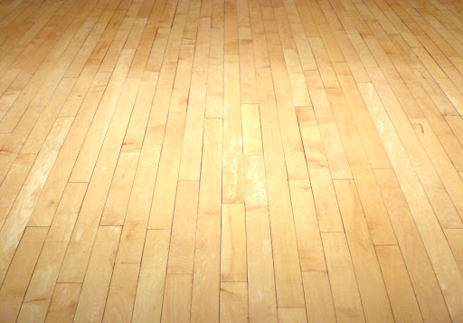
YOUR HOUSE, YOUR CHOICE! (AT-HOME PE)
SQUAT CHALLENGE
PLAY OUTSIDE (30 MINS.)
WOULD YOU RATHER PT. 1
JUMP ROPE (20 MINS.)
MONDAY
TABATA
INSIDE THE HOUSE GAME
FAMILY WALK OR RUN
JUST DANCE
TUESDAY
KOO KOO KANGA ROO
PLAY OUTSIDE (30 MINS.)
TABATA
WOULD YOU RATHER PT. 2
WEDNESDAY
JUMP ROPE (20 MINS.)
15 MIN. WORKOUT
KOO KOO KANGA ROO
JUST DANCE
THURSDAY
INSIDE THE HOUSE GAME
FAMILY WALK OR RUN
SQUAT CHALLENGE
COUCH ISLAND
FRIDAY
CHOOSE ONE ACTIVITY TO DO EACH DAY. THERE ARE A TOTAL OF FOUR WEEKS WORTH OF ACTIVITIES. YOU WILL NEED TO CLICK ON THE BLUE LINK FOR SOME OF THE ACTIVITIES. WEEKENDS ARE FREE CHOICE! STAY ACTIVE & STAY HEALTHY!

